Slide 1
A Blockchain Implementation For Secured Vaccine Certificates
Presented by:
Jennifer fadriquela

Slide 2
Objectives of the Study
This study aims to design and develop an application that will integrate blockchain and IPFS to ensure the integrity of vaccination data.
Specifically, the study seeks to address the following objectives:
1. To apply Proof of Authority (PoA) blockchain and Keccak Hash Algorithm in maintaining transactional records.
2. To apply concept of Merkle DAG for data storage.
3. To validate security aspects of the proposed application by using Solidity Security Audits based from Smart Contract Weakness Classification Registry (SWC Registry). The security audits namely:
a. Securify (Trail of Bits)
b. Slither (Chain Security)

Slide 3
MERKLE DAG

Slide 4
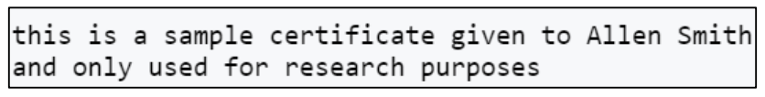
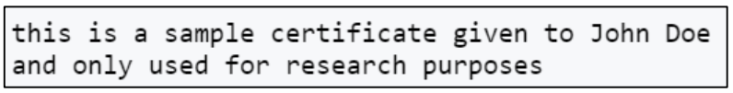
File 1
Name: cert_allen_smith.txt
Size: 86 bytes
File 2
Name: cert_john_doe.txt
Size: 83 bytes

Slide 5
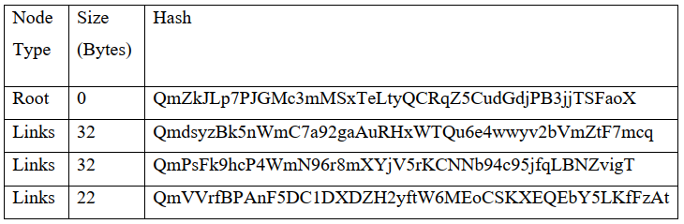
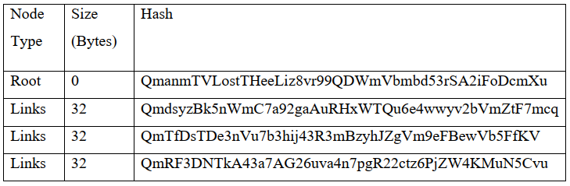
cert_allen_smith.txt
cert_john_doe.txt

Slide 6
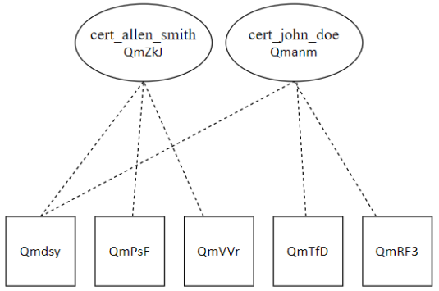

Slide 7
Proof of authority Clique

Slide 8
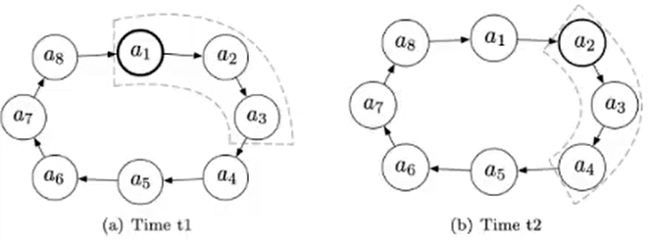
Concept of Inturn and Noturn validators
After signing a block, validators are not allowed to sign the next floor(SIGNER_COUNT / 2) + 1 blocks
Gives preference to chain built with INTURN validators
Blocks have a higher difficulty depending when they are made
DIFF_INTURN = 2
DIFF_NOTURN = 1

Slide 9
Validator Set Changes
Authorities vote for validator set changes
For non-epoch transition blocks
Signers may cast one vote per own block to propose authorization
Only latest proposal per target beneficiary is kept from a single signer
Votes are tallied live as the chain progresses
Proposals reaching majority consensus SIGNER_LIMIT come into effect immediately

Slide 10
Epochs
Smart contracts require state access
Need way to verify authorities without access to state
An epoch block is a stateless transition
Contain no votes
Contain list of authorities
All non-settled votes are discarded
Can be used as a checkpoint for clients syncing the network
Default is every 30,000 blocks

Slide 11
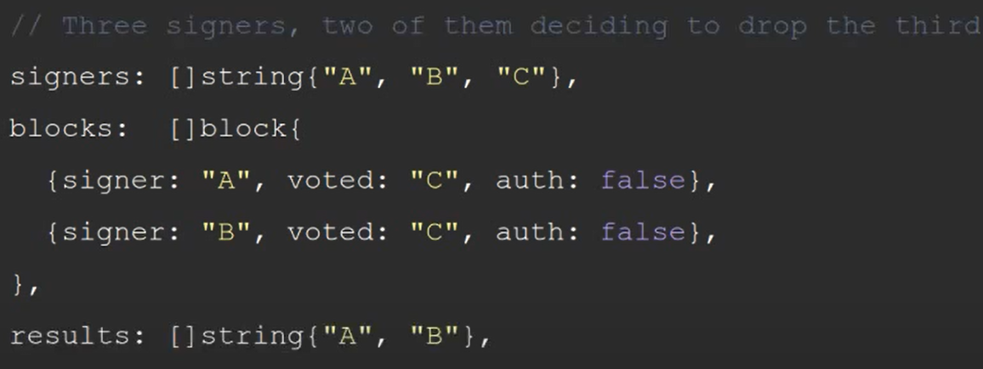
Scenario 1

Slide 12
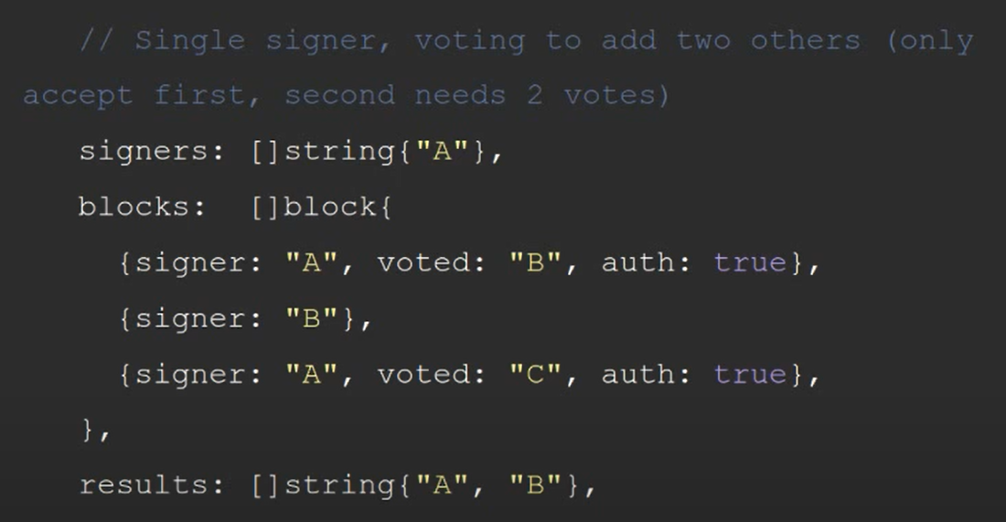
Scenario 2

Slide 13
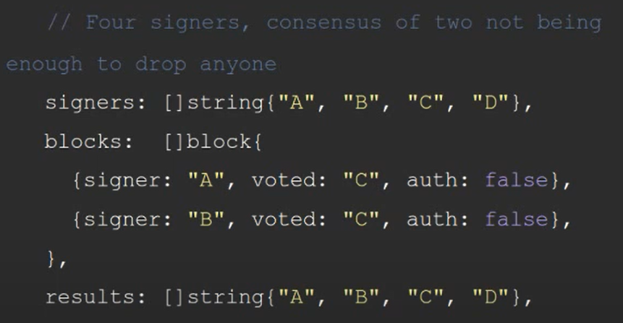
Scenario 3

Slide 14
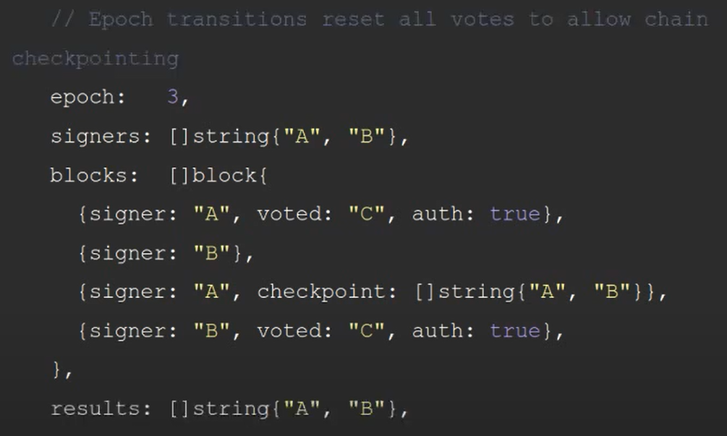
Scenario 4

Slide 15
KECCAK

Slide 16
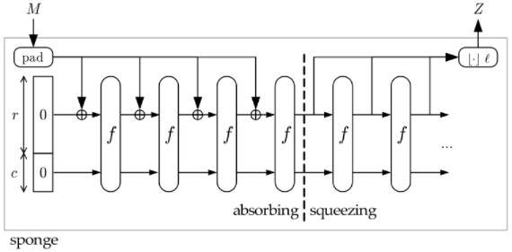
Keccak uses the sponge construction where the message blocks are XORed into the initial bits of the state, and then invertibly permuted. The sponge function takes a simple function f and involves a number of stages, and where we create a fixed output (dependent on the bit length of the hash function). Simple operations of XOR, AND, and bit shifts are used, and which leads to a fast generation of the hash function
Notes:
Sample simulation on docs

Slide 17
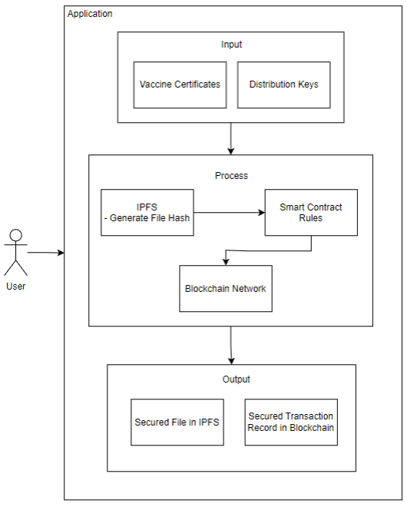
Conceptual Framework

Slide 18
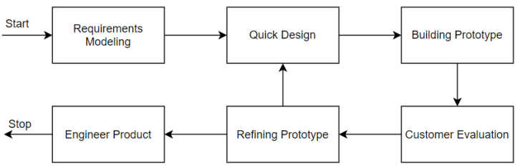
Methodology

Slide 19
REQUIREMENTS MODELING

Slide 20
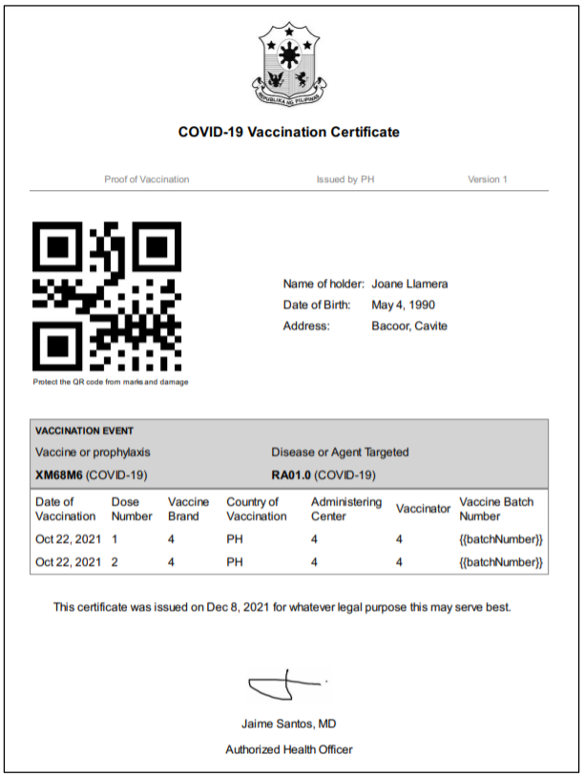

Slide 21
Requirements grouped by specific role:
Patient
- Register and Login – register to gain access to the system
o Upon registration, system will create private and public keys to be used for data encryption
- Download Vaccine Certificate
- View QR Code for Vaccine Record Summary
- View Record Summary Details
Verifying Third Party
- Publicly Available
- Validate Vaccine Certificate if existing in system
Physician/Medical Unit
- Register and Login – register to gain access to the system
- Create vaccine record for patient

Slide 22
SYSTEM FUNCTIONALITIES

Slide 23
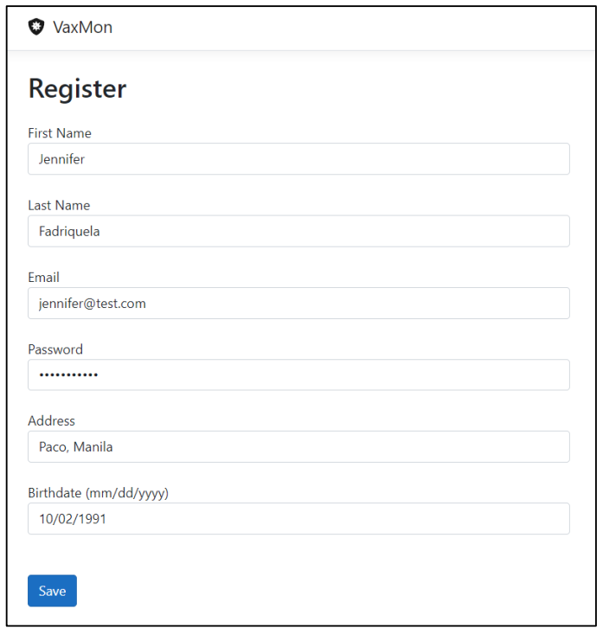
PATIENT REGISTRATION

Slide 24
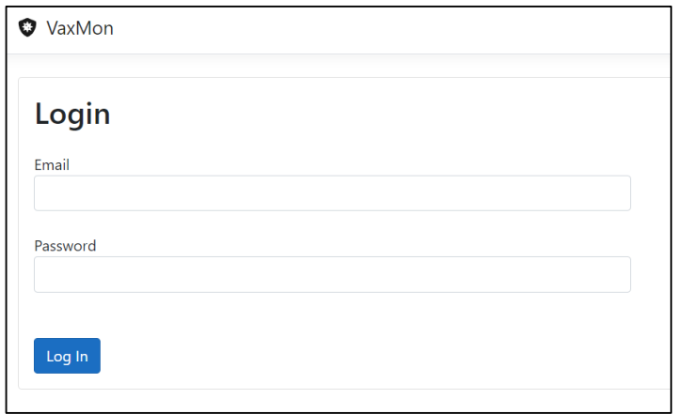
PATIENT LOGIN

Slide 25
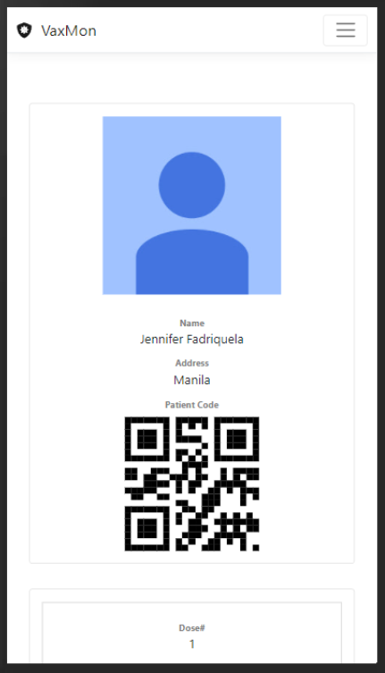
PATIENT HOME SCREEN - 1

Slide 26
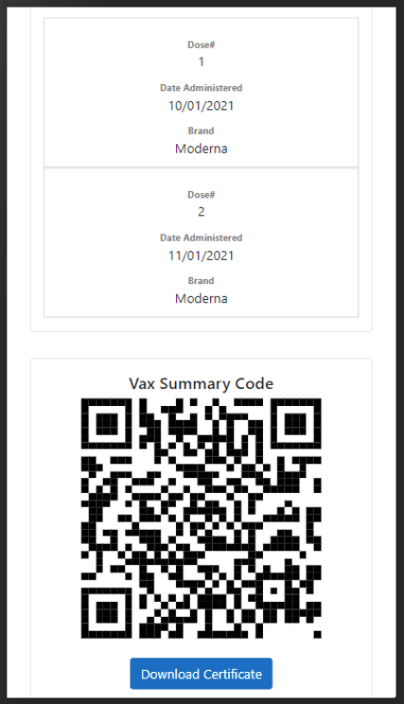
PATIENT HOME SCREEN - 2

Slide 27
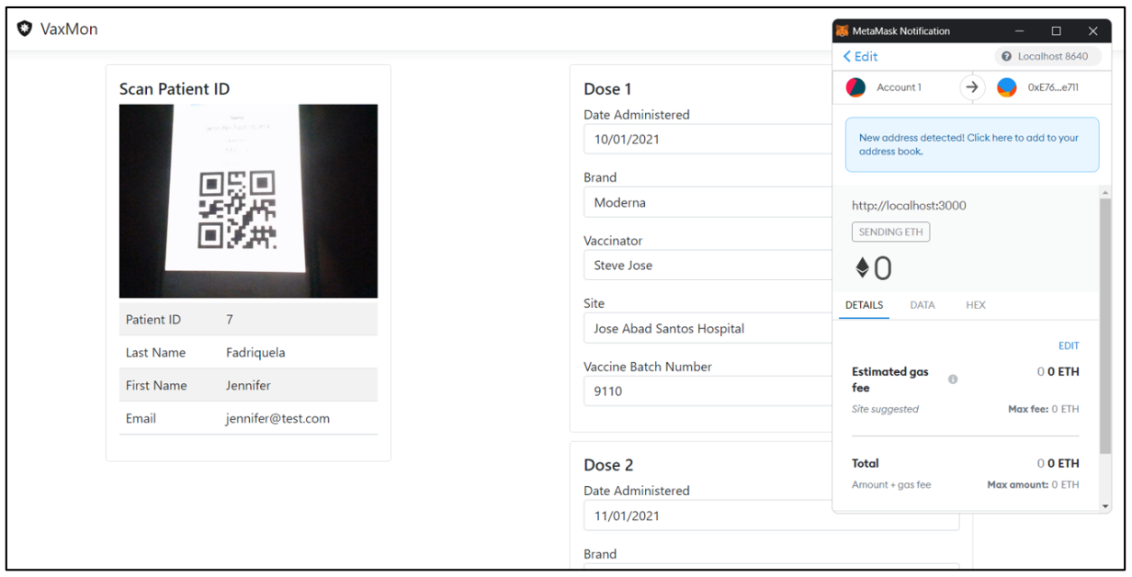
Vaccine record creation

Slide 28
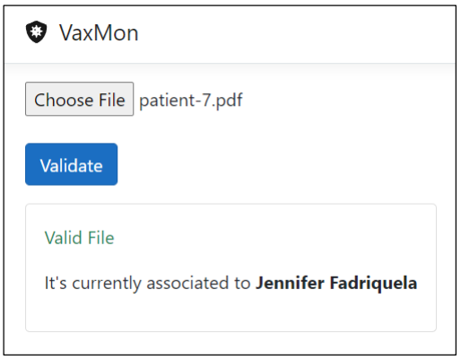
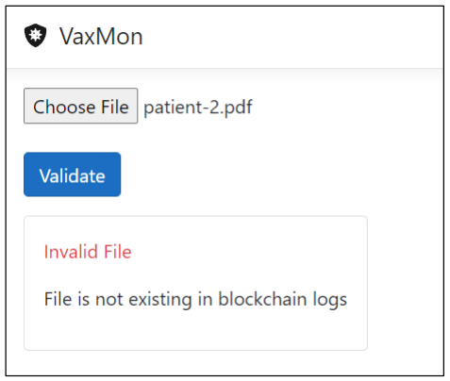
VACCINE CERTIFICATE VALIDATION

Slide 29
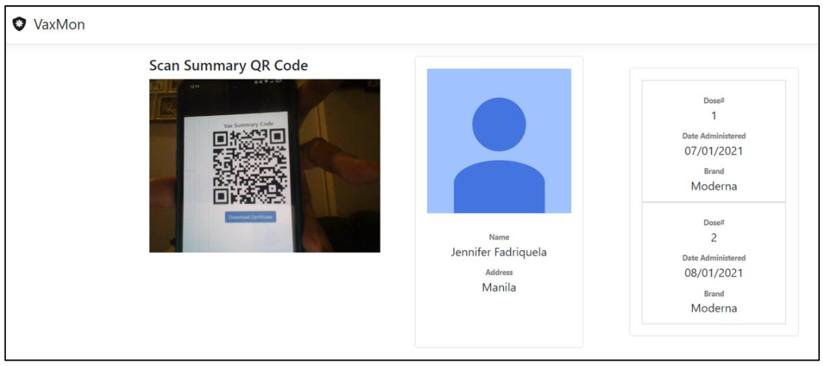
SCAN SUMMARY QR CODE

Slide 30
SECURITY AUDITS RESULTS

Slide 31
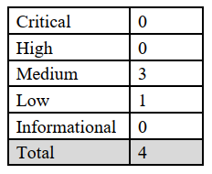
SECURIFY RESULTS
Medium (All 3)
Missing Input Validation - Method arguments must be sanitized before they are used in computation
Low
Solidity pragma directives – Avoid complex solidity version pragma statements

Slide 32
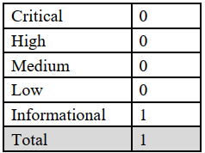
SLITHER RESULTS
Informational
Pragma version is too complex

